Slide 1
Geometric View of data
David Kauchak CS 158 – Fall 2023

Slide 2
Admin
Assignment 2 out and due on Sunday
Assignment 1 solution posted under the “Resources” tab on sakai (use them to debug!)
Assignment 1 back soon
Keep reading
Mentor hours Friday, 7-9pm and Sunday, 7-9pm
Office hours:
Mon/Wed: 3-4pm
Thurs: 2:30-4pm

Slide 3

Proper Experimentation

Slide 4
Experimental setup
REAL WORLD USE OF ML ALGORITHMS
past
future
predict
learn
Training
Data
Testing
Data
(data with labels)
(data without labels)
How do we tell how well we’re doing?

Slide 5
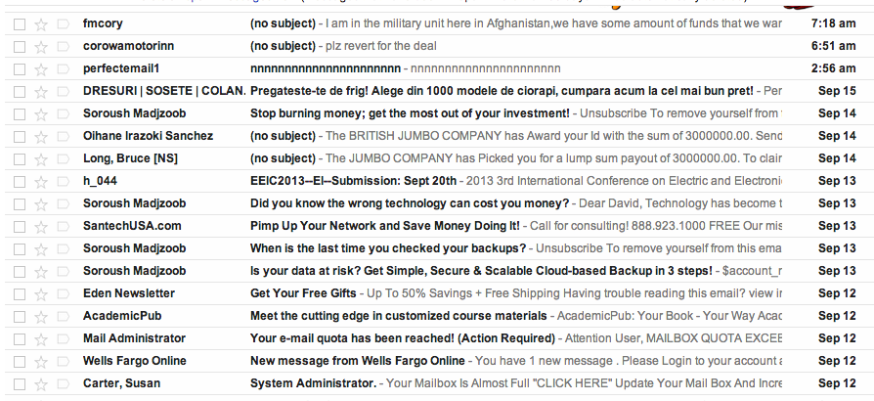
Real-world classification
Google has labeled training data, for example from people clicking the “spam” button, but when new messages come in, they’re not labeled

Slide 6
Classification evaluation
Data
Label
0
Use the labeled data we have already to create a test set with known labels!
Why can we do this?
0
Labeled data
1
1
0
We assume there’s an underlying distribution that generates both the training and test examples
1
0

Slide 7
Classification evaluation
Data
Label
Training data
0
0
1
Labeled data
1
0
1
Testing data
0

Slide 8
Classification evaluation
Data
Label
Training data
0
0
classifier
1
Labeled data
train a
classifier
1
0
1
Testing data
0

Slide 9
Classification evaluation
Data
Label
1
0
Pretend like we don’t know the labels

Slide 10
Classification evaluation
Data
Label
1
1
classifier
1
0
Pretend like we don’t know the labels
Classify

Slide 11
Classification evaluation
Data
Label
1
1
classifier
1
0
Pretend like we don’t know the labels
Classify
How could we score these for classification?
Compare predicted labels to actual labels

Slide 12
Test accuracy
To evaluate the model, compare the predicted labels to the actual labels
Accuracy: the proportion of examples where we correctly predicted the label
prediction
Label

Slide 13
Proper testing
Training
Data
learn
One way to do algorithm development:
try out an algorithm
evaluate on test data
repeat until happy with results
Test
Data
Is this ok?
Evaluate model
No. Although we’re not explicitly looking at the examples, we’re still “cheating” by biasing our algorithm to the test data

Slide 14
Proper testing
Once you look at/use test data it is no longer test data!
Test
Data
Evaluate model
So, how can we evaluate our algorithm during development?

Slide 15
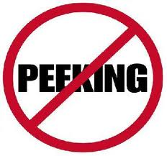
Development set
Training
Data
All Training
Data
Development
Data
Labeled
Data
Test
Data
(data with labels)

Slide 16
Proper testing
Training
Data
learn
Using the development data:
try out an algorithm
evaluate on development data
repeat until happy with results
When satisfied, evaluate on test data
Development
Data
Evaluate model

Slide 17
Proper testing
Training
Data
learn
Using the development data:
try out an algorithm
evaluate on development data
repeat until happy with results
Development
Data
Any problems with this?
Evaluate model

Slide 18
Overfitting to development data
Be careful not to overfit to the development data!
Training
Data
All Training
Data
Development
Data
Often we’ll split off development data multiple times (in fact, on the fly)… you can still overfit, but this helps avoid it

Slide 19
Pruning revisited
Unicycle
Mountain
Normal
Unicycle
Mountain
Normal
YES
Terrain
Road
Trail
YES
NO
Weather
NO
Rainy
Sunny
Unicycle
Snowy
Mountain
Normal
NO
YES
NO
YES
Terrain
Road
Trail
Which should we pick?
YES
NO

Slide 20
Pruning revisited
Unicycle
Mountain
Normal
Unicycle
Mountain
Normal
YES
Terrain
Road
Trail
YES
NO
Weather
NO
Rainy
Sunny
Unicycle
Snowy
Mountain
Normal
NO
YES
NO
YES
Terrain
Road
Trail
Use development data to decide!
YES
NO

Slide 21
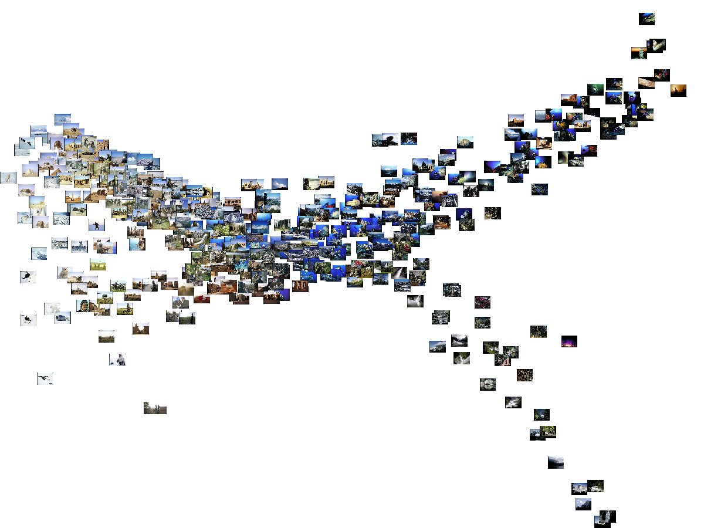
Machine Learning: A Geometric View

Slide 22
Apples vs. Bananas
Weight | Color | Label
4 | Red | Apple
5 | Yellow | Apple
6 | Yellow | Banana
3 | Red | Apple
7 | Yellow | Banana
8 | Yellow | Banana
6 | Yellow | Apple
Can we visualize this data?

Slide 23
Apples vs. Bananas
Turn features into numerical values
(read the book for a more detailed
discussion of this)
Weight | Color | Label
4 | 0 | Apple
5 | 1 | Apple
6 | 1 | Banana
3 | 0 | Apple
7 | 1 | Banana
8 | 1 | Banana
6 | 1 | Apple
1
A
B
B
B
A
Color
0
A
A
0
5
10
Weight
We can view examples as points in an n-dimensional space where n is the number of features

Slide 24
Examples in a feature space
feature₂
label 1
label 2
label 3
feature₁

Slide 25
Test example: what class?
feature₂
label 1
label 2
label 3
feature₁

Slide 26
Test example: what class?
feature₂
label 1
label 2
closest to red
label 3
feature₁

Slide 27
Another classification algorithm?
To classify an example d:
Label d with the label of the closest example to d in the training set

Slide 28
What about this example?
feature₂
label 1
label 2
label 3
feature₁

Slide 29
What about this example?
feature₂
label 1
label 2
closest to red, but…
label 3
feature₁

Slide 30
What about this example?
feature₂
label 1
Most of the next closest are blue
label 2
label 3
feature₁

Slide 31
k-Nearest Neighbor (k-NN)
To classify an example d:
Find k nearest neighbors of d
Choose as the label the majority label within the k nearest neighbors

Slide 32
k-Nearest Neighbor (k-NN)
To classify an example d:
Find k nearest neighbors of d
Choose as the label the majority label within the k nearest neighbors
How do we measure “nearest”?

Slide 33
Euclidean distance
In two dimensions, how do we compute the distance?
(b₁, b₂)
(a₁, a₂₎

Slide 34
Euclidean distance
In n-dimensions, how do we compute the distance?
(b₁, b₂,…,b_{n})
(a₁, a₂, …, a_{n)}

Slide 35
Euclidean distance
In n-dimensions, how do we compute the distance?
(b₁, b₂,…,b_{n})
(a₁, a₂, …, a_{n)}
Measuring distance/similarity is a domain-specific problem and there are many, many different variations!

Slide 36
Decision boundaries
The decision boundaries are places in the features space where the classification of a point/example changes
label 1
label 2
label 3
Where are the decision boundaries for k-NN?

Slide 37
k-NN decision boundaries
label 1
label 2
label 3
k-NN gives locally defined decision boundaries between classes

Slide 38
Choosing k
What is the label with k = 1?
feature₂
label 1
label 2
label 3
feature₁

Slide 39
Choosing k
We’d choose red. Do you agree?
feature₂
label 1
label 2
label 3
feature₁

Slide 40
Choosing k
What is the label with k = 3?
feature₂
label 1
label 2
label 3
feature₁

Slide 41
Choosing k
We’d choose blue. Do you agree?
feature₂
label 1
label 2
label 3
feature₁

Slide 42
Choosing k
What is the label with k = 100?
feature₂
label 1
label 2
label 3
feature₁

Slide 43
Choosing k
We’d choose red. Do you agree?
feature₂
label 1
label 2
label 3
feature₁

Slide 44
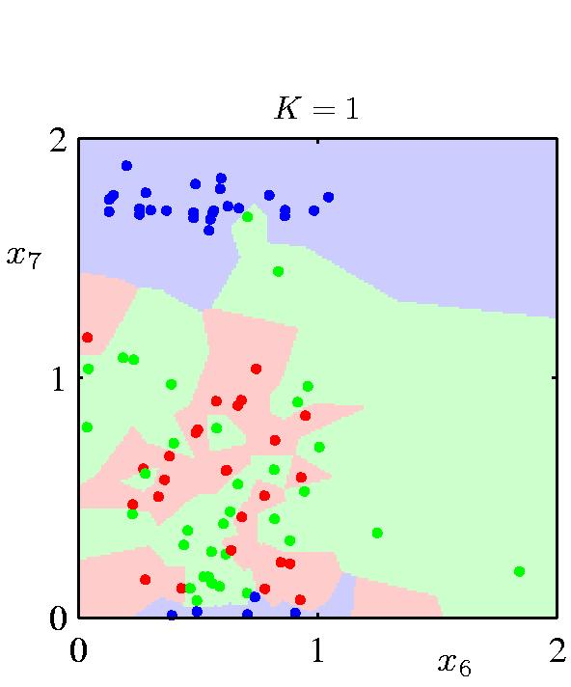
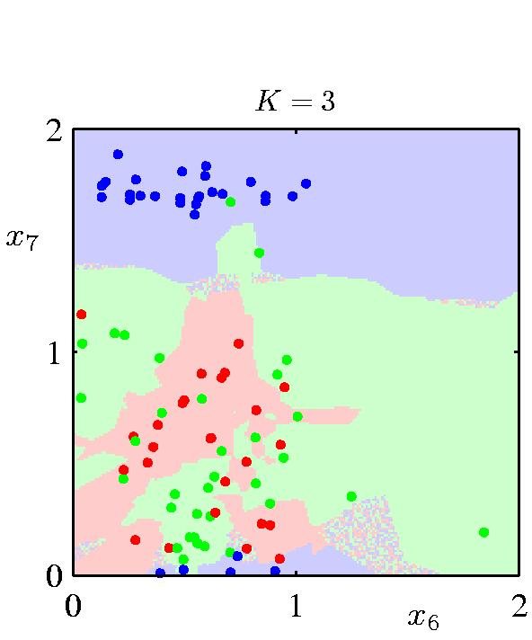
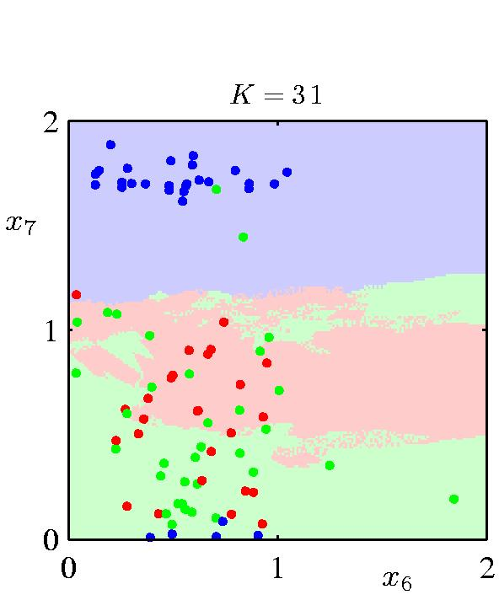
The impact of k
What is the role of k?
How does it relate to overfitting and underfitting?
How did we control this for decision trees?

Slide 45
k-Nearest Neighbor (k-NN)
To classify an example d:
Find k nearest neighbors of d
Choose as the class the majority class within the k nearest neighbors
How do we choose k?

Slide 46
How to pick k
Common heuristics:
often 3, 5, 7
choose an odd number to avoid ties
Use development data

Slide 47
k-NN variants
To classify an example d:
Find k nearest neighbors of d
Choose as the class the majority class within the k nearest neighbors
Any variation ideas?

Slide 48
k-NN variations
Instead of k nearest neighbors, count majority from all examples within a fixed distance
Weighted k-NN:
Right now, all examples are treated equally
weight the “vote” of the examples, so that closer examples have more vote/weight
often use some sort of exponential decay

Slide 49
Decision boundaries for decision trees
label 1
label 2
label 3
What do the decision boundaries for decision trees like?

Slide 50
Decision boundaries for decision trees
label 1
label 2
label 3
Axis-aligned splits/cuts of the data

Slide 51
Decision boundaries for decision trees
label 1
label 2
label 3
What types of data sets will DT work poorly on?

Slide 52
Problems for DT

Slide 53
Decision trees vs. k-NN
Which is faster to train?
Which is faster to classify?
Do they use the features in the same way to label the examples?

Slide 54
Decision trees vs. k-NN
Which is faster to train?
k-NN doesn’t require any training!
Which is faster to classify?
For most data sets, decision trees
Do they use the features in the same way to label the examples?
k-NN treats all features equally! Decision trees “select” important features

Slide 55
Machine learning models
Some machine learning approaches make strong assumptions about the data
If the assumptions are true it can often lead to better performance
If the assumptions aren’t true, the approach can fail miserably
Other approaches don’t make many assumptions about the data
This can allow us to learn from more varied data
But, they are more prone to overfitting
and generally require more training data

Slide 56
Data generating distribution
We are going to use the probabilistic model of learning
There is some probability distribution over example/label pairs called the data generating distribution
Both the training data and the test set are generated based on this distribution
What is a probability distribution?

Slide 57
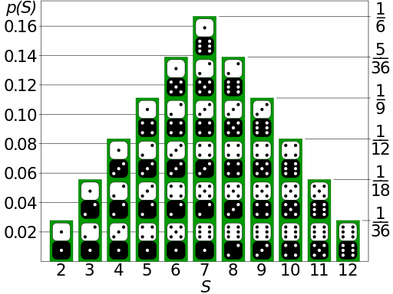
Probability distribution
Describes how likely (i.e. probable) certain events are
Describes probabilities for all possible events
Probabilities are between 0 and 1 (inclusive)
Sum of probabilities over all events is 1

Slide 58

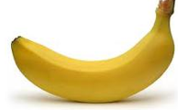
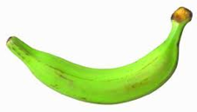
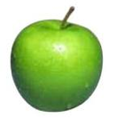
data generating distribution
Training data
Test set
data generating distribution

Slide 59
What is the data generating distribution?

Slide 60
What is the data generating distribution?

Slide 61
What is the data generating distribution?

Slide 62
What is the data generating distribution?

Slide 63
What is the data generating distribution?

Slide 64
What is the data generating distribution?

Slide 65
Actual model

Slide 66
Model assumptions
If you don’t have strong assumptions about the model, it can take you a longer to learn
Assume now that our model of the blue class is two circles

Slide 67
What is the data generating distribution?

Slide 68
What is the data generating distribution?

Slide 69
What is the data generating distribution?

Slide 70
What is the data generating distribution?

Slide 71
What is the data generating distribution?

Slide 72
Actual model

Slide 73
What is the data generating distribution?
Knowing the model beforehand can drastically improve the learning and the number of examples required

Slide 74
What is the data generating distribution?

Slide 75
Make sure your assumption is correct, though!

Slide 76
Machine learning models
What are the model assumptions (if any) that k-NN and decision trees make about the data?
Are there data sets that could never be learned correctly by either?

Slide 77
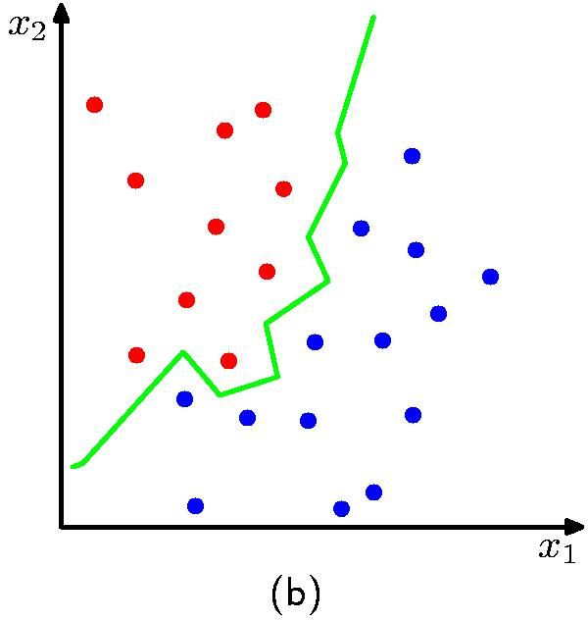
k-NN model
K = 1
No model assumptions. Assumes that proximity relates to class
Notes:
NO model assumptions
does assume that proximity in the feature space relates to class
kNN can learn any arbitrary separation between the classes

Slide 78
Decision tree model
label 1
label 2
label 3
Axis-aligned splits/cuts of the data
Notes:
Assumes the data is separable by axis-aligned splits
Fairly week assumption
many things it can’t learn perfectly

Slide 79
Bias
The “bias” of a model is how strong the model assumptions are.
low-bias classifiers make minimal assumptions about the data (k-NN and DT are generally considered low bias)
high-bias classifiers make strong assumptions about the data

Slide 80
Linear models
A strong high-bias assumption is linear separability:
in 2 dimensions, can separate classes by a line
in higher dimensions, need hyperplanes
A linear model is a model that assumes the data is linearly separable

